Slide 1
初识Pynq
房彪

Slide 2
Outline
Introduction PYNQ-Z2
Jupyter Notebooks based on PYNQ-Z2
PYNQ-Z2 Overlays
How to develop self define overlays？
Some Examples
Reference
Further work

Slide 3
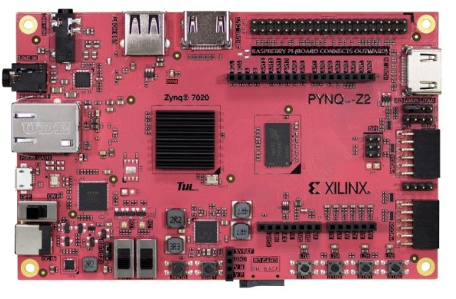
Introduction PYNQ-Z2
ZYNQ 7020 SOC based
ARM 667 Mhz
Dual Core
512MB DDR3
HDMI,USB,Ethernet,Pmod
MIC input and output
UART
And more……

Slide 4
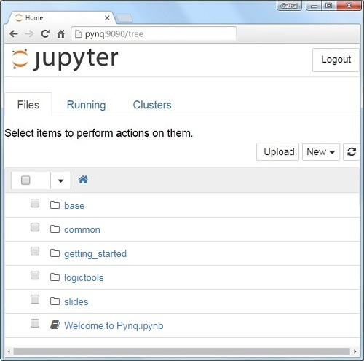
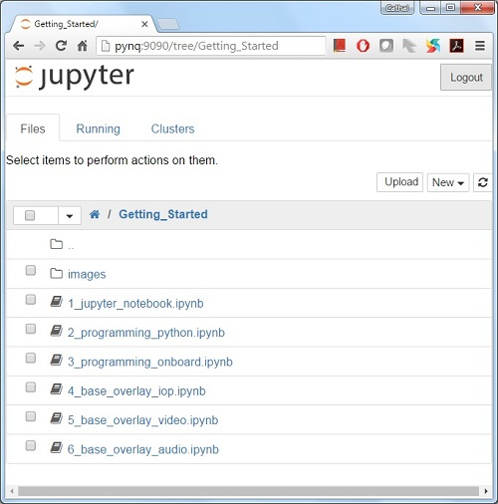
Jupyter Notebooks based on PYNQ-Z2
http://pynq:9090

Slide 5
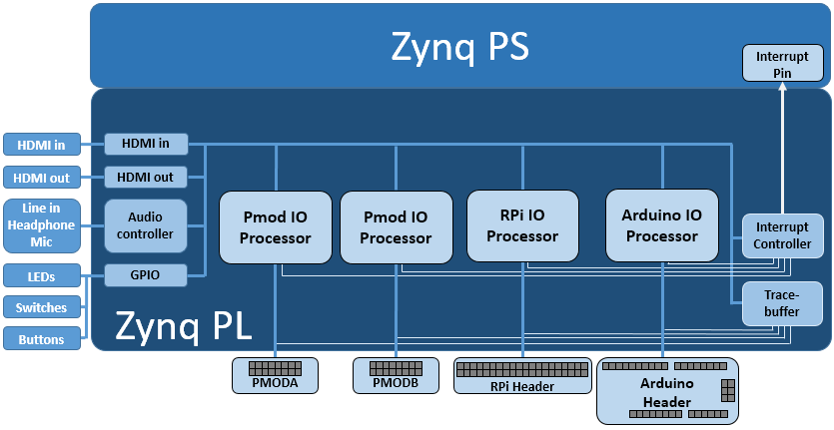
PYNQ-Z2 Overlays
HDMI (Input and Output)
Audio codec
User LEDs, Switches, Pushbuttons
2x Pmod PYNQ Micro Blaze
Arduino PYNQ Micro Blaze
RPi (Raspberry Pi) PYNQ Micro Blaze
4x Trace Analyzer (PMODA, PMODB, ARDUINO, RASPBERRYPI)
Notes:
The Xilinx® Zynq® All Programmable device is an SOC based on a dual-core ARM® Cortex®-A9 processor (referred to as the Processing System or PS), integrated with FPGA fabric (referred to as Programmable Logic or PL). The PS subsystem includes a number of dedicated peripherals (memory controllers, USB, Uart, IIC, SPI etc) and can be extended with additional hardware IP in a PL Overlay.
Overlays, or hardware libraries, are programmable/configurable FPGA designs that extend the user application from the Processing System of the Zynq into the Programmable Logic. Overlays can be used to accelerate a software application, or to customize the hardware platform for a particular application.
For example, image processing is a typical application where the FPGAs can provide acceleration. A software programmer can use an overlay in a similar way to a software library to run some of the image processing functions (e.g. edge detect, thresholding etc.) on the FPGA fabric. Overlays can be loaded to the FPGA dynamically, as required, just like a software library. In this example, separate image processing functions could be implemented in different overlays and loaded from Python on demand.
PYNQ provides a Python interface to allow overlays in the PL to be controlled from Python running in the PS. FPGA design is a specialized task which requires hardware engineering knowledge and expertise. PYNQ overlays are created by hardware designers, and wrapped with this PYNQ Python API. Software developers can then use the Python interface to program and control specialized hardware overlays without needing to design an overlay themselves. This is analogous to software libraries created by expert developers which are then used by many other software developers working at the application level.

Slide 6
Overlay Design Methodology
Feature
Available python IP
Board Settings
PS-PL Interface
MicroBlaze Soft Processors
Python/C Integration
Python AsyncIO
Python Overlay API
Python Packaging
AXI GPIO
AXI DMA (simple mode only)
AXI VDMA
AXI Interrupt Controller (internal use)
Pynq-Z1 Audio IP
Pynq-Z1 HDMI IP
Color convert IP
Pixel format conversion
HDMI input and output frontends
Pynq Microblaze program loading

Slide 7
Overlay Design Methodology
Setup1.
Setup2.
PL IP development
PS python Application and driver Dev
Setup3.
Merge

Slide 8
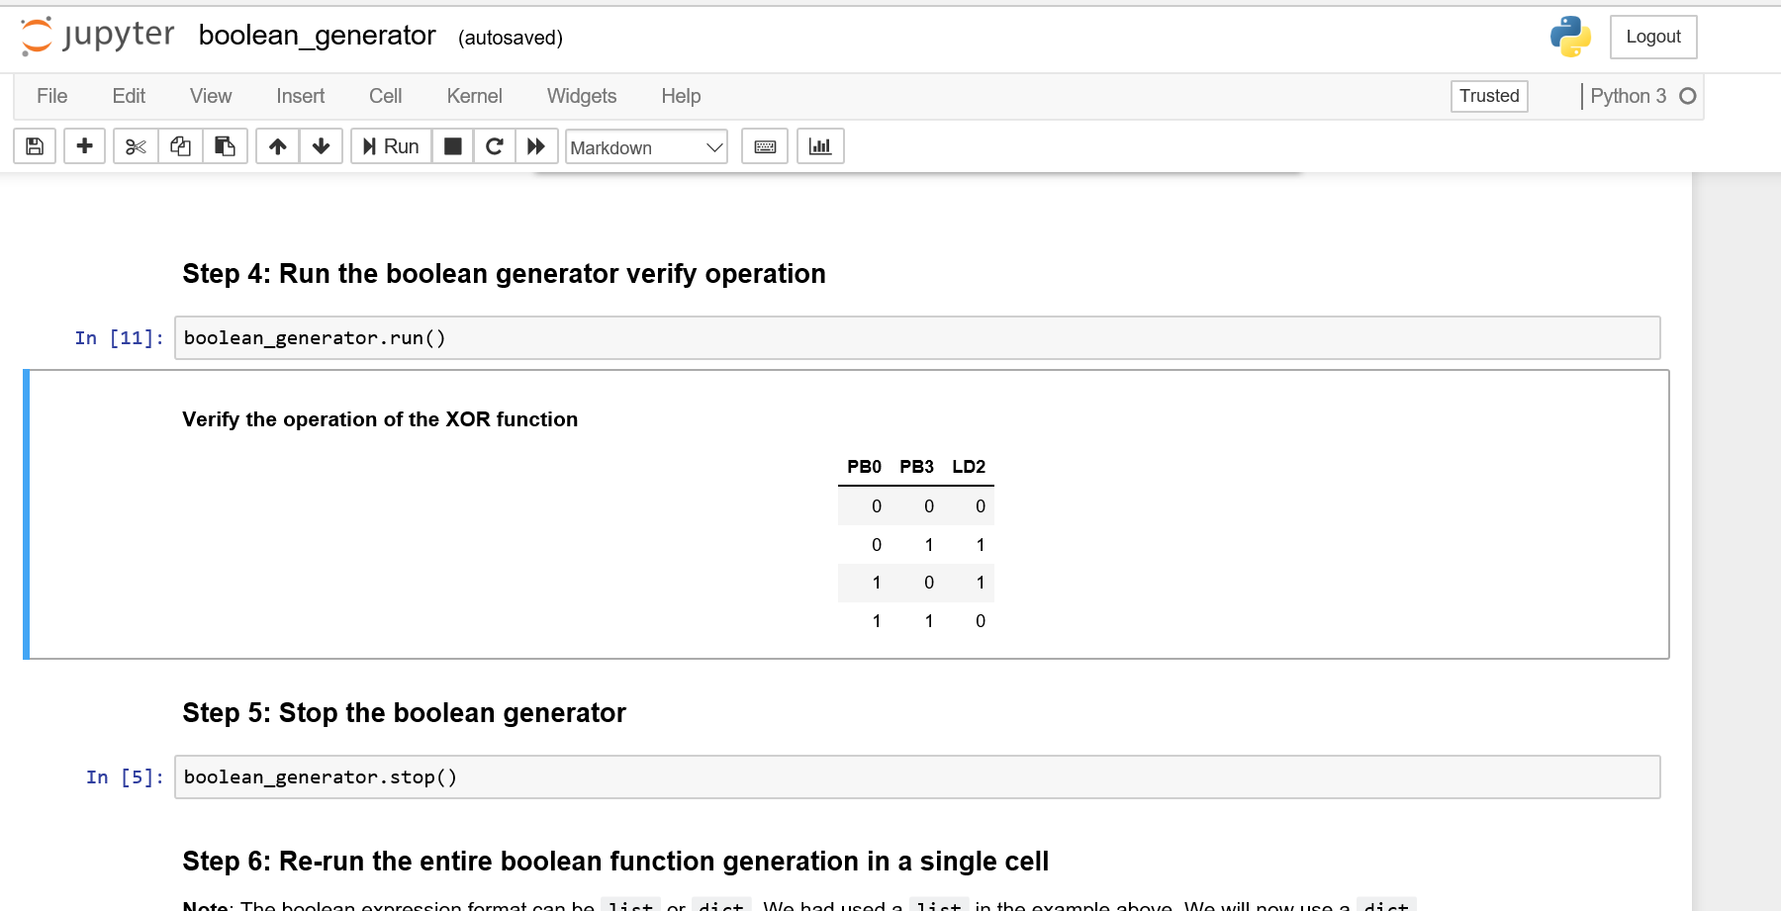
Some Examples
LED
DMA
官方给的Demo还有一点问题

Slide 9
Reference
https://pynq.readthedocs.io/en/v2.2.1/
Pynq productivity report and user guide.pdf

Slide 10
Further work
自己的板子目前还缺SD读卡器，今天下午去购买，明天就开测了。
基于测pynq方面的东西

